Slide 1





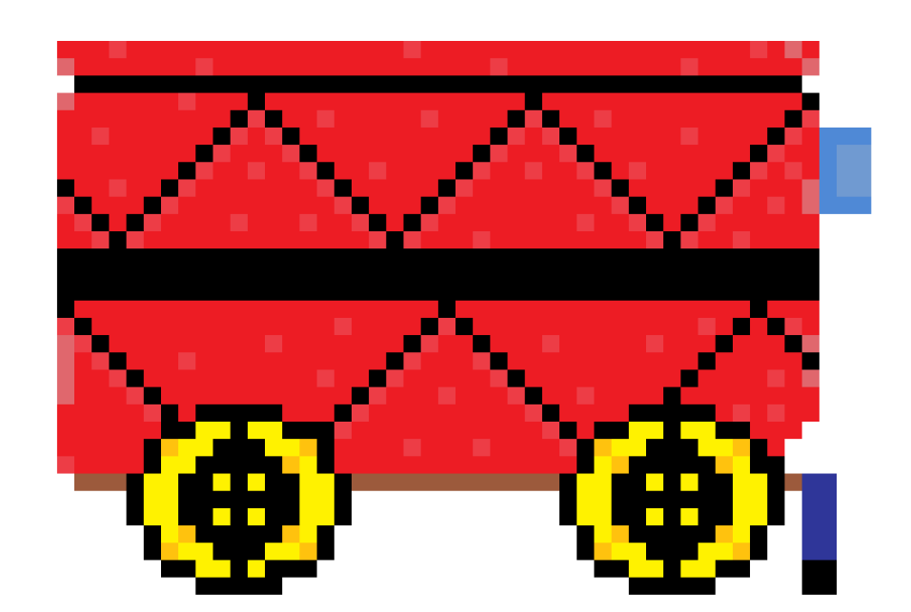
CAR-LOS:
LINE FOLLOWER car
Presented by: Team ASAP-z
Arfa(Leader), Shreya, Amay, Parvathi, Zainab

Slide 2


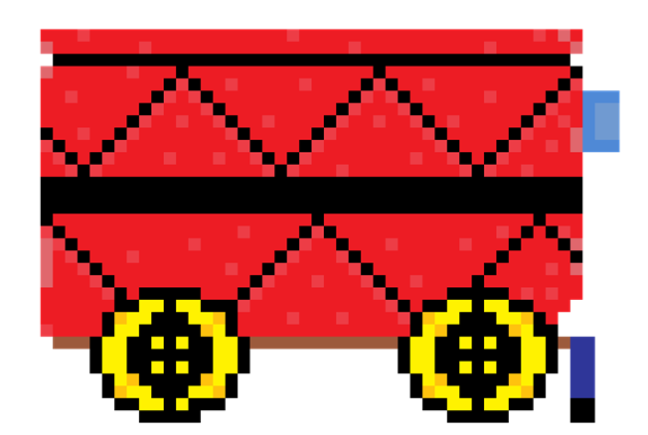
INTRODUCTION
At team ASAP-Z, We have created a line following robot using Arduino named Carlos that is capable of avoiding obstacles and following a line.
Carlos was created with the intent of delivery of goods and services. We wanted to minimize the amount of work used for delivery of smaller goods.

Slide 3
WIRING

Slide 4

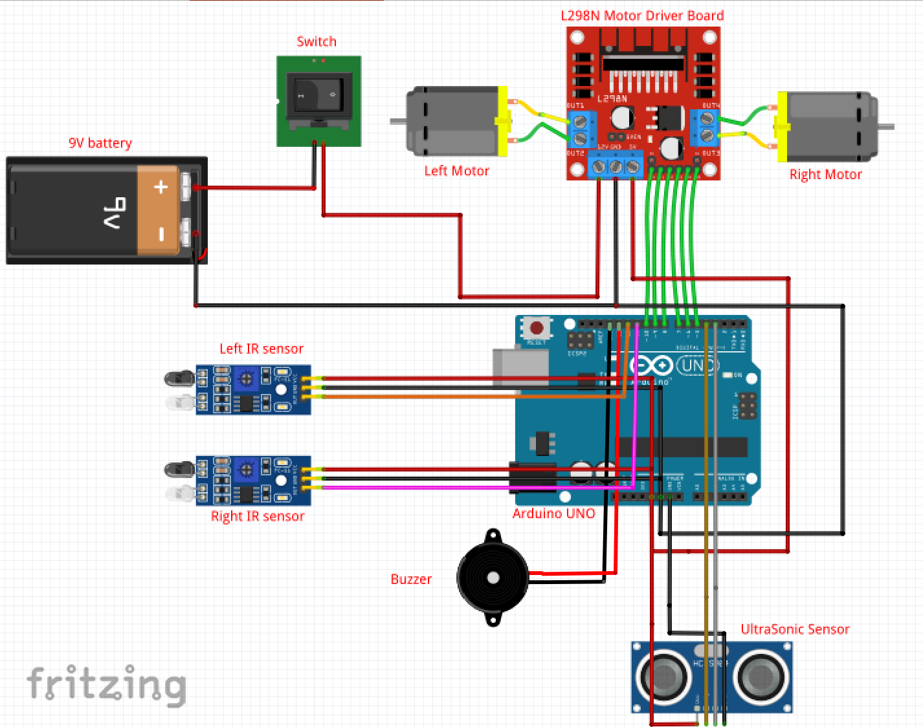
WIRING
Presented by Zainab
To connect the IR sensors, motors, and the motor driver
together we connect the motors to the motor driver output
pins, and then all the pins on the motor driver from ENA to
ENB is connected to digital pins of the Arduino board. Then
we soldered the +5V and GND of the Arduino to +5V and GND
of the motor driver and to the VCC and GND pins of both the IR sensors respectively.
Now to connect the ultrasonic sensor we attached both the
ground pins of the Arduino and the ultrasonic sensor. Echo
and trig is attached to D4, D5 pins of the Arduino UNO. VCC
of the ultrasonic sensor is attached to the 5V of the Arduino.
To attach the switch and battery we soldered wires coming
from the negative side of the battery to the GND of the motor driver (and then we use this wire to connect to the rest of the components). The 12V pin of motor driver is connected to one pin of the switch and the other pin is connected to the
positive pin of the battery.

Slide 6

PROGRAMMING

Slide 7
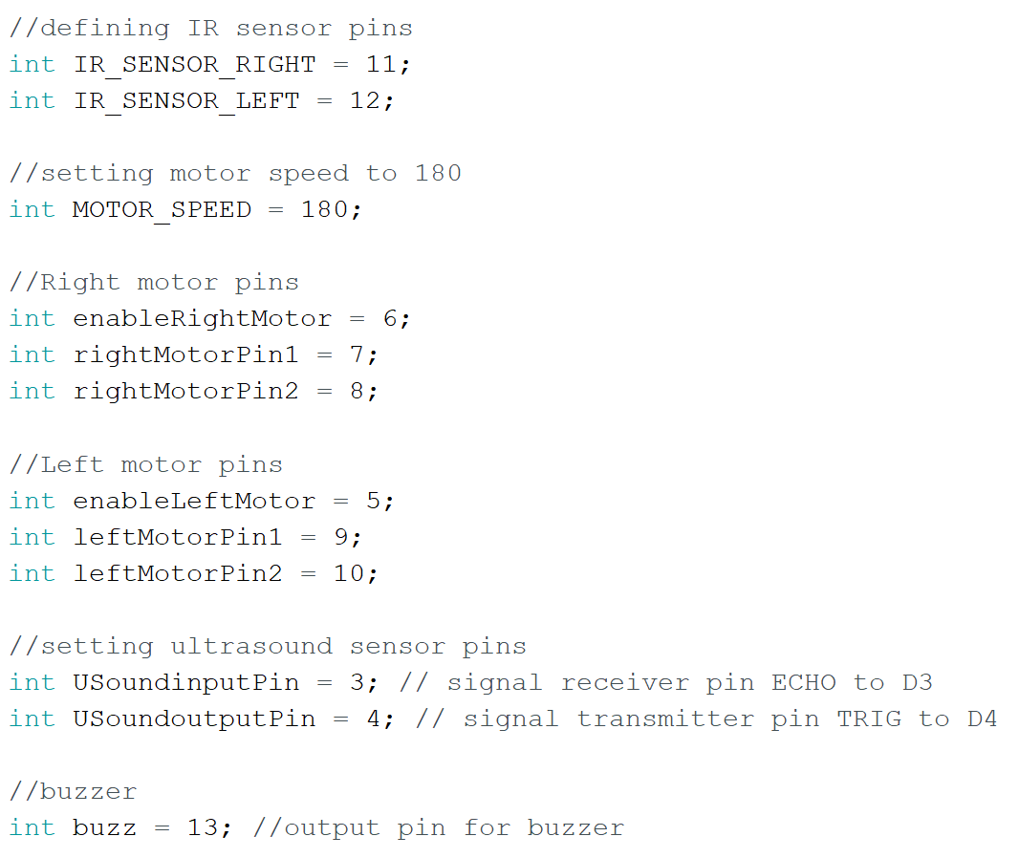
PROGRAMMING
Presented by Arfa and Amay
We first set up the input and output pins for various components of the car, such as IR sensors, an ultrasound sensor, motors, and a buzzer. The IR sensors' pins are defined as IR_SENSOR_RIGHT and IR_SENSOR_LEFT, while the speed of the motors is set to 180. The pins for the right and left motors are defined, along with the pins for the ultrasound sensor and the buzzer.
.

Slide 8
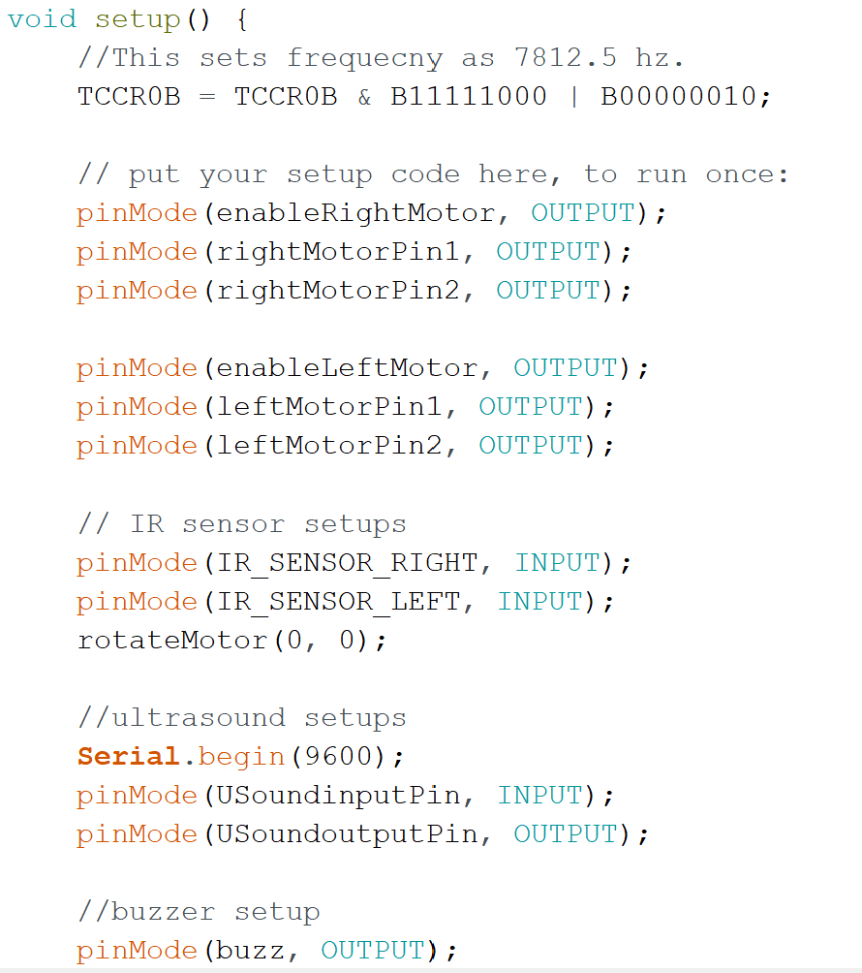
PROGRAMMING
Presented by Arfa and Amay
VOID setup()
This part of the code runs once, setting up the pin modes and initialises the motor control and sensors for the line-following car.
The function TCCR0B sets the frequency of the PWM signal for the motor control pins, which is set to 7812.5 Hz.
The pin modes for the motor control pins are set as output.
The pin modes for the IR sensors and ultrasound sensors are set as input, with the serial communication for the ultrasound sensor being set to 9600 baud.
The pin mode for the buzzer is set as output.
The function "rotateMotor(0, 0)" is called to stop the motors initially.
.

Slide 9
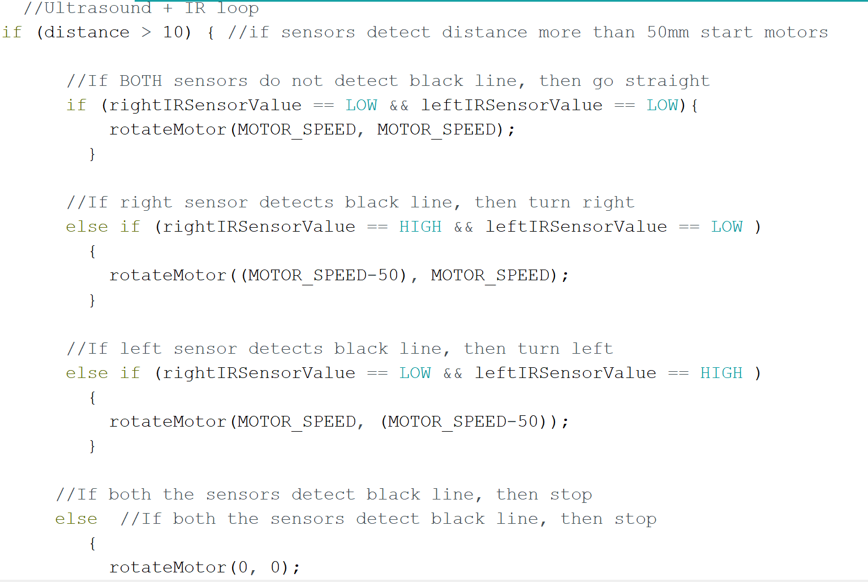
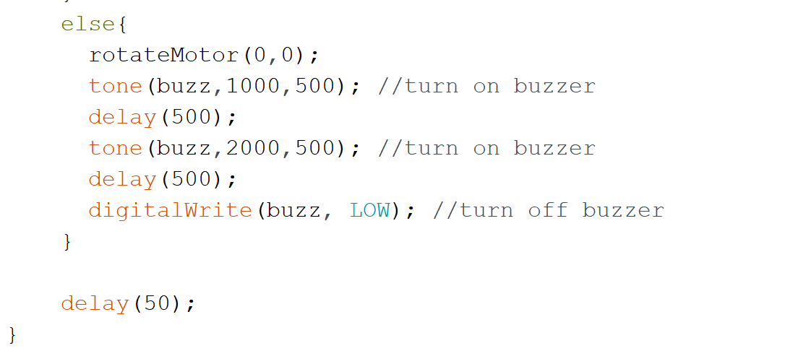
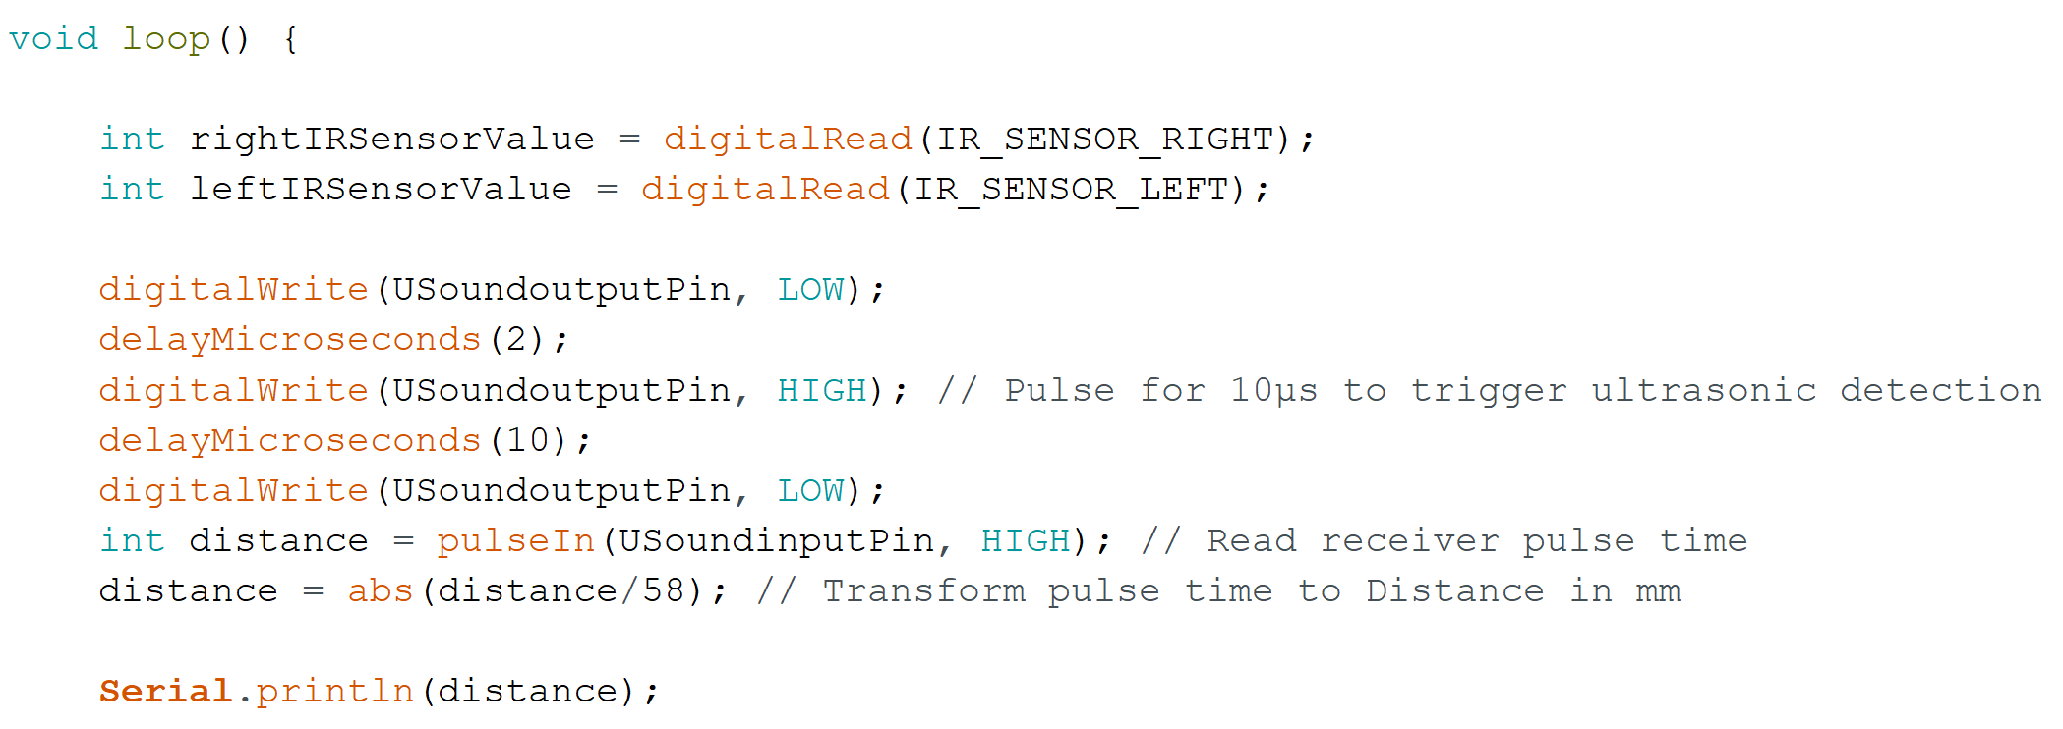
PROGRAMMING
Presented by Arfa and Amay
VOID LOOP()
This code is the main loop of a program for a robot that uses IR sensors and ultrasonic sensors to detect black lines and obstacles. The program reads the values from the IR sensors and ultrasonic sensor, then decides what actions to take based on those readings.
If the ultrasonic sensor detects a distance greater than 10mm, the program checks the values of the IR sensors. If both IR sensors read low (not detecting a black line), the program drives the motors forward at a set speed. If the right IR sensor detects a black line, the program turns the right motor off or slows it down, causing the robot to turn to the right. If the left IR sensor detects a black line, the program turns the left motor off or slows it down, causing the robot to turn to the left. If both IR sensors detect a black line, the program stops the motors.
If the ultrasonic sensor detects an obstacle within 10mm, the program stops the motors and activates a buzzer for a short time to alert the user. The loop then repeats, continuously checking for updates from the sensors and deciding what actions to take.

Slide 10
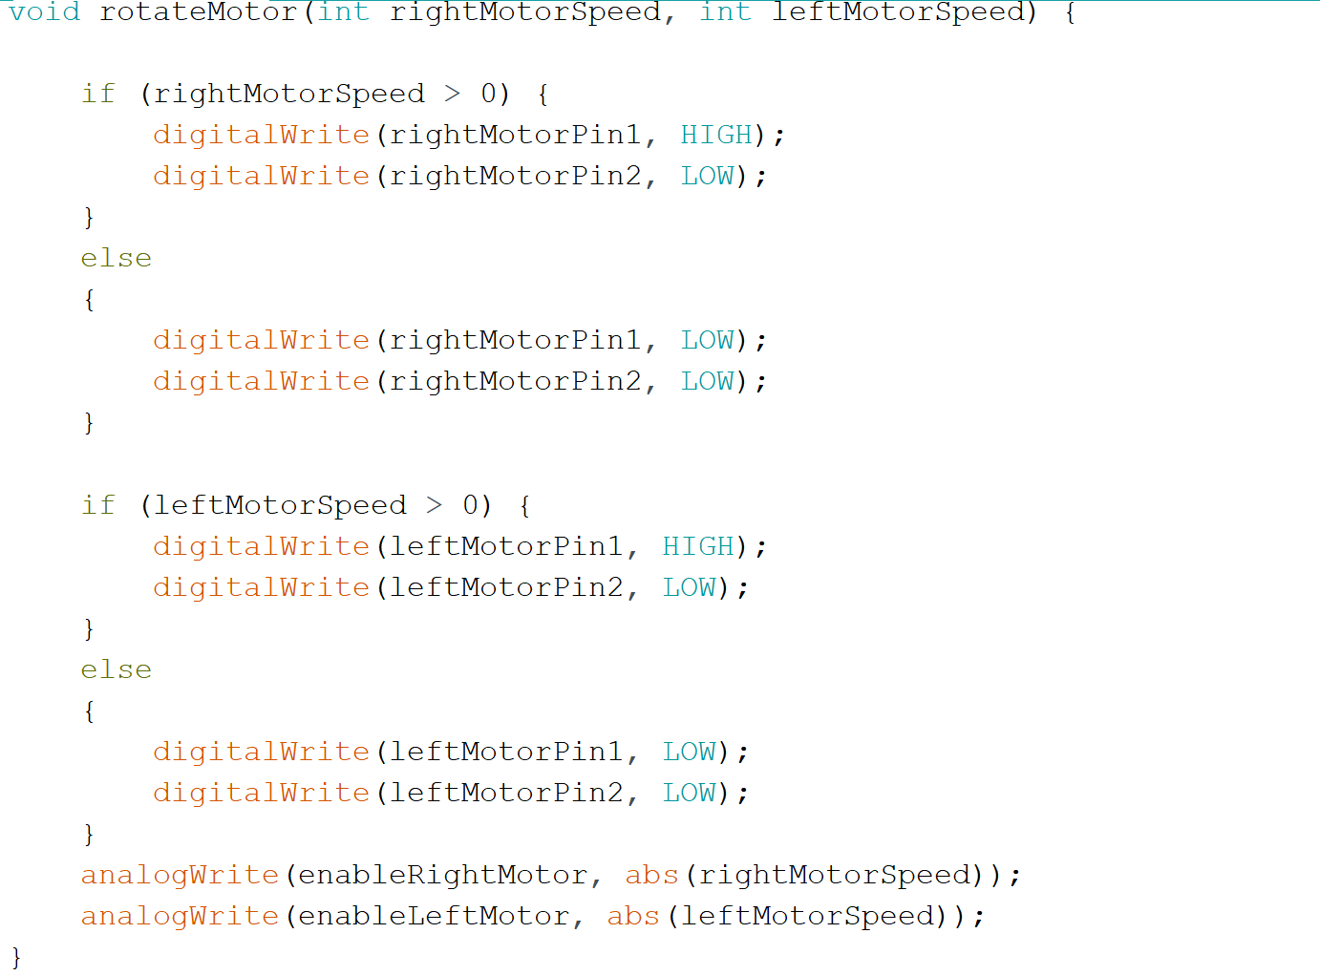
PROGRAMMING
Presented by Arfa and Amay
rotateMotor()
The rotateMotor function is used to control the speed and direction of two motors in the robot. It takes two parameters rightMotorSpeed and leftMotorSpeed, which determine the speed of the right and left motors, respectively. If rightMotorSpeed is greater than 0, the right motor rotates forward. If rightMotorSpeed is 0 or less, the right motor stops. If leftMotorSpeed is greater than 0, the left motor rotates forward. If leftMotorSpeed is 0 or less, the left motor stops. The function sets the direction of the motors using digitalWrite and the speed of the motors using analogWrite.

Slide 11

ASSEMBLY

Slide 12
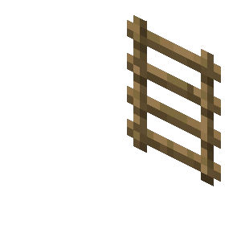
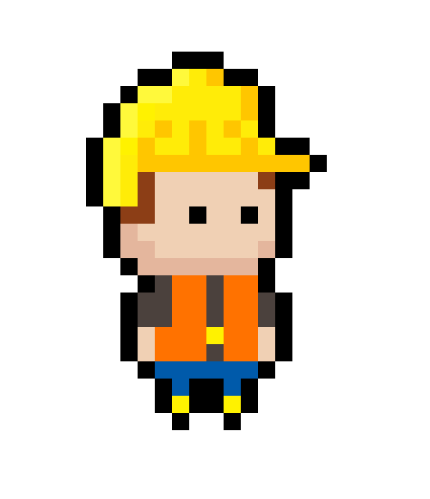
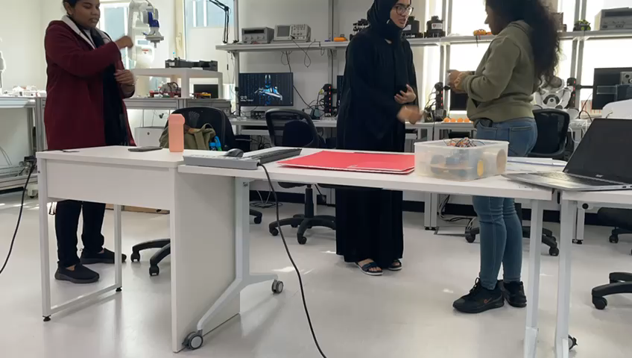
ASSEMBLY
Presented by Parvathi and Shreya
We positioned the wires on the motors and securely fastened them to the chassis after connecting the wires to the motors. The tires were all then mounted to the chassis and securely fastened. Following component wiring, double-sided tape was used to attach the components to the chassis. Carlos' structural design uses a red foam board, red tape, and holes cut in the board to insert a buzzer, a USB connector, and an ultrasonic sensor. The structural base is covered with a red glossy paper. Finally, we placed both IR sensors on the chassis by using Glue Gun at a distance of 6 cm. We used white foam board and black tape to design the road. After drawing its layout, we applied the black tape to the road's framework. Once this was complete we tested the car on the road.

Slide 13

LATE Delivery
Non-SUSTAINABLE
Goods ordered are late due to human delivery and bad weather conditions. Problems arise sometimes due to navigation and increases the delivery time.
The environment is harmed by CO2 emitted by vehicles used for delivery. Fuel production for these vehicles is often also a cause for pollution.
Common
problems
Financials
Usability
A substantial amount of money is invested by people to delivery services and for the maintenance of the delivery vehicles.
Customers want something that’s easy to adopt and simple to use. Complicated delivery services do not attract people.

Slide 14
Arrives on Time
Carlos can arrive on time without delay. It can navigate through busy streets and crowded areas with ease. The use of Carlos eliminates the need for human drivers, thus reducing the chances of mistakes and ensuring that goods is delivered quickly and accurately.
SUSTAINANBLE
Carlos does not harm the environment since it is fully electric. Carlos eliminates the carbon footprint and allowing goods delivery companies to be more socially responsible.
SOLUTIONS
Cost savings
Easy to use
Reduce costs for client by reducing the delivery charges substantially. Using Carlos eliminates the need to pay salaries and benefits to human drivers and reduces the maintenance and repair cost of vehicles.
Carlos in of itself is simple and efficient to use. Carlos also can be easily scaled up or down to meet the changing needs of the business.

Slide 15

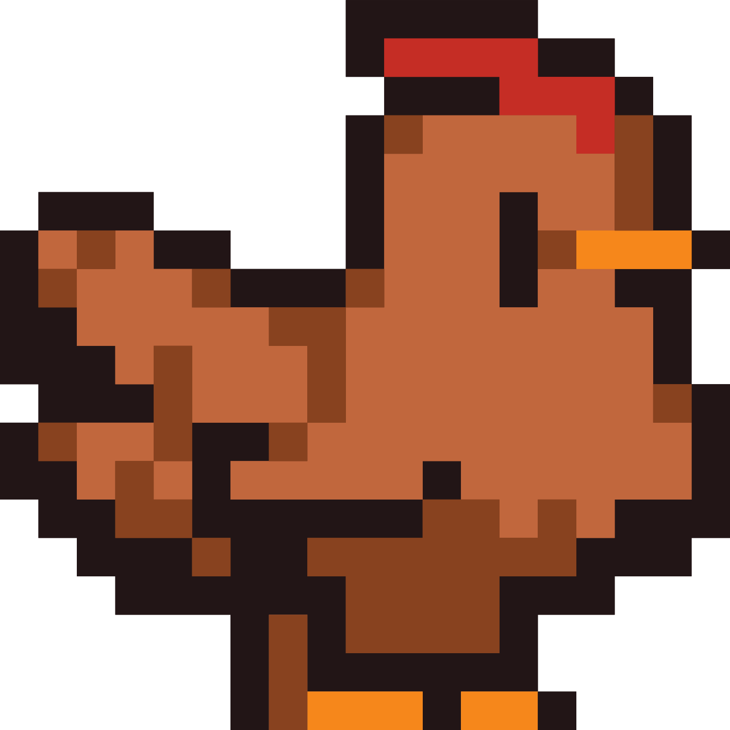
BENEFITS
Obstacle Detection and Avoidance
Carlos can detect and avoid obstacles in its path, ensuring that goods arrives at its destination on time and in perfect condition.
Improved Navigation
Carlos is equipped with advanced sensors and technology that allows it to navigate.
Durable and Reliable
Carlos is designed to be highly durable and reliable, making it the perfect choice for busy restaurants and goods delivery companies.

Slide 16
BENEFITS
Uninterrupted Services: Carlos can work around the clock, thus increasing the number of deliveries that can be made in a given time period.
Safety: Carlos is designed to reduce the risk of accidents caused by human error.
USER FRIENDLY: Carlos is easy to set up and use and can be integrated into existing delivery systems.

Slide 17
TIME FOR DEMONSTRATION

Slide 18
THANK YOU FOR LISTENING!
Don't hesitate to ask any questions!

